Slide 1
Analytical Instrumentation
Prof. Sujit M. Deokar,
Department of Instrumentation Engg.
Vishwakarma Institute of Technology, Pune
Lecture 03 :
Physical Properties of Electromagnetic Radiation

Slide 2
Recap:
Atoms in Hindu Scriptures
John Dalton’s Theory
Fundamental Components of elementary particles
Modern Atomic theory
Nuclear Reaction
Electronic Structures of Atoms

Slide 3
Index
Atomic Orbital
Atomic Orbital: P – Orbital
Energy Levels
Periodic Table
Electromagnetism
Properties of Electromagnet Radiation
Electromagnetic Spectrum

Slide 4
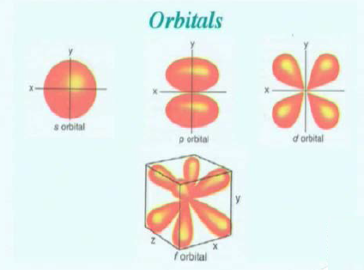
Atomic Orbital

Slide 5
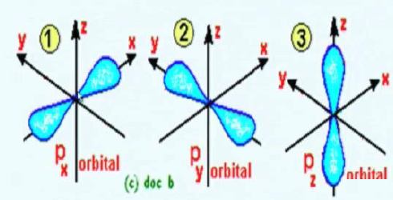
Atomic Orbital: P - orbital

Slide 6
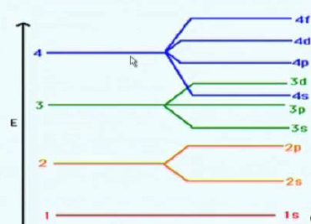
Energy Levels

Slide 7
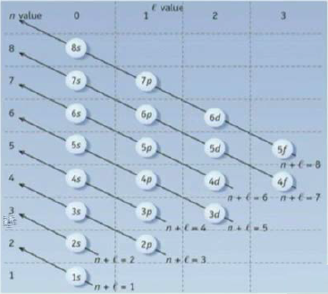
Energy level Diagram fro Atomic Orbital

Slide 8
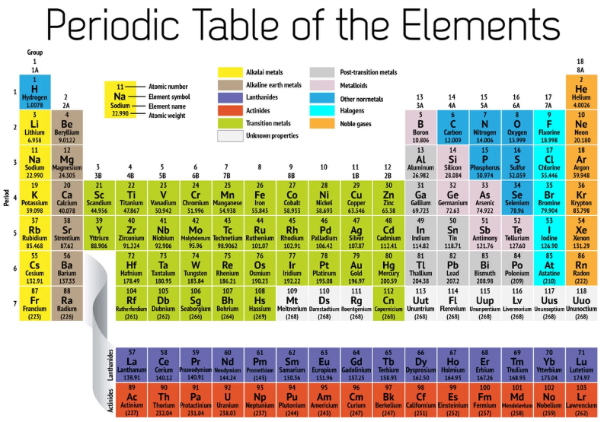

Slide 9
Electromagnetism
The knowledge of the exact order in which atomic orbitals are occupied is based on the interpretation of atomic spectra in terms of how spectral lines result from permitted electronic transitions. Heavier atoms have complicated atomic spectral patterns and overlaps occurring in the similar systems

Slide 10
What is electromagnetic radiation?
The characteristics of electromagnetic radiations are best described by a classical sinusoidal wave model.
Phenomenon associated with such processes can be explained by considering the electromagnetic radiation as a continuous stream of discrete particles of energy called as photons.
The wave particle duality of the electromagnetic radiation is basically complimentary to each other and rationalized by wave mechanics.
So, a plane-polarized electromagnetic radiation of a particular frequency follows a sinusoidal oscillation along the direction in which the wave is propagating.

Slide 11

Mathematically, an electromagnetic wave can be described as a sine wave,
where, A is the amplitude at any point;
A 0 is the peak amplitude;
theta is the continuous variable.

Slide 12

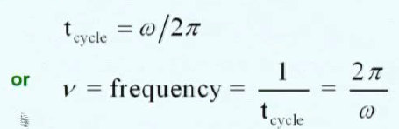
Alternately
where, omega t is equal to theta and omega is the angular velocity in radians per unit time.
A complete cycle occurs when w t changes from 0 to 360 degrees. This is called one complete oscillation or one period.

Slide 13
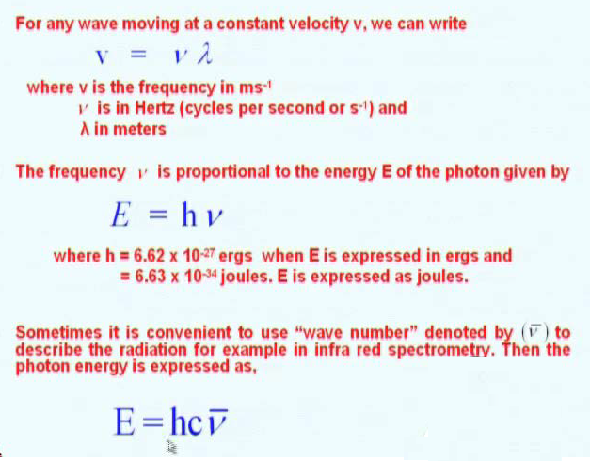

Slide 14
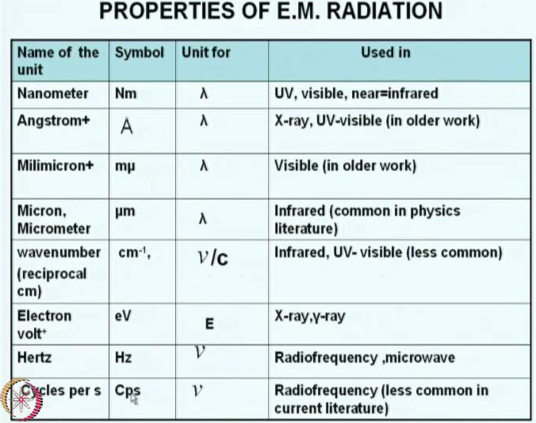

Slide 15
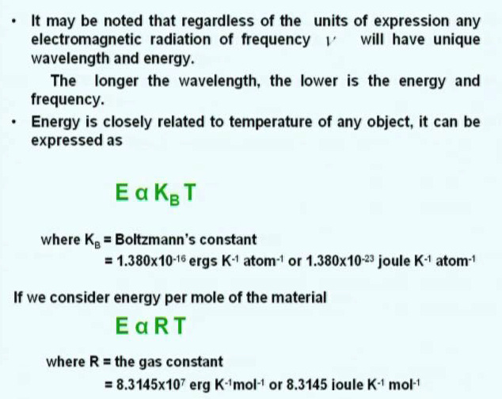

Slide 16

The energy of the photons should not be confused with the brightness or intensity of the source. But, it relates to the colour of the light.
The power of a light source is given by,
It is the energy of a beam of radiation that reaches a given area per second.
Intensity of a source of radiation is the power emanating per unit solid angle.

Slide 17
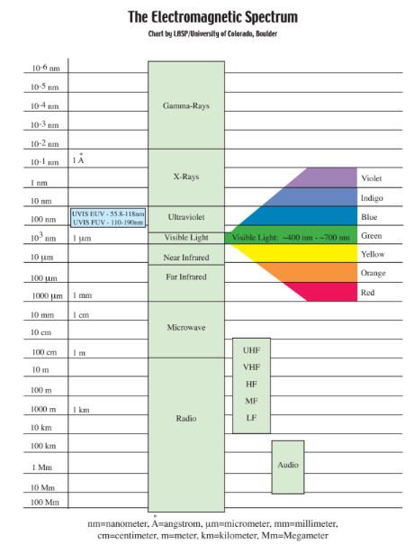

Slide 18
Radiation Transmission
The interaction of matter with the instrument components
Interaction of the electromagnetic radiation with the sample.

